Slide 1
Probabilistic Programming
Marius Popescu
popescunmarius@gmail.com
2025 - 2026

Slide 2
Project
Marius Marogel - marius.marogel@s.unibuc.ro
Marius Popescu - popescunmarius@gmail.com
Factions in Social Networks

Slide 3
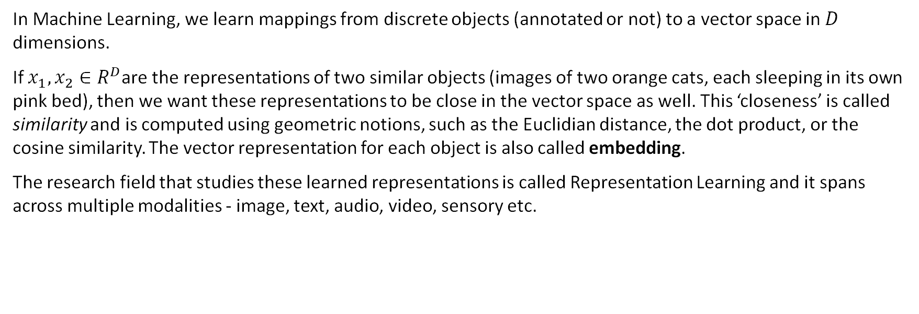
Dense Vector Representations
In Machine Learning, we learn mappings from discrete objects (annotated or not) to a vector space in $D$ dimensions.
If $x_{1},x_{2}∈R^{D}$are the representations of two similar objects (images of two orange cats, each sleeping in its own pink bed), then we want these representations to be close in the vector space as well. This ‘closeness’ is called similarity and is computed using geometric notions, such as the Euclidian distance, the dot product, or the cosine similarity. The vector representation for each object is also called embedding.
The research field that studies these learned representations is called Representation Learning and it spans across multiple modalities - image, text, audio, video, sensory etc.

Slide 4
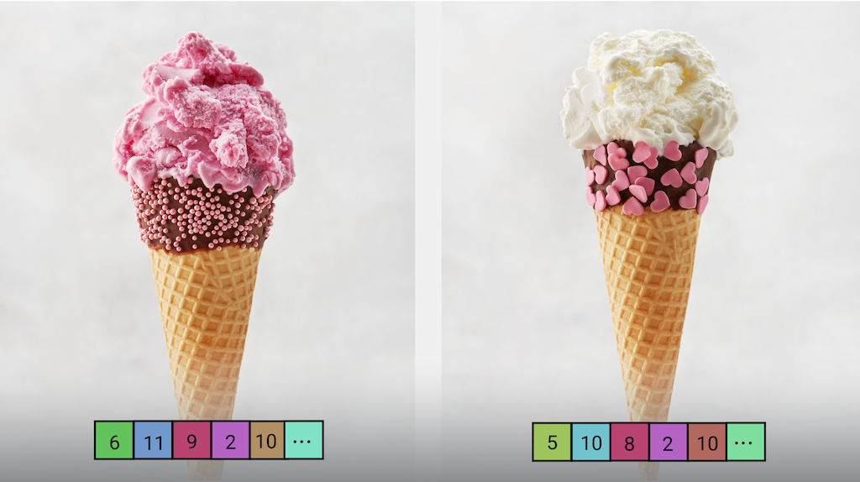
Image Embeddings in CV
Google’s MediaPipe Image Embedder
https://ai.google.dev/edge/mediapipe/solutions/vision/image_embedder
Two very similar images like these may share similar magnitudes in certain dimensions.

Slide 5
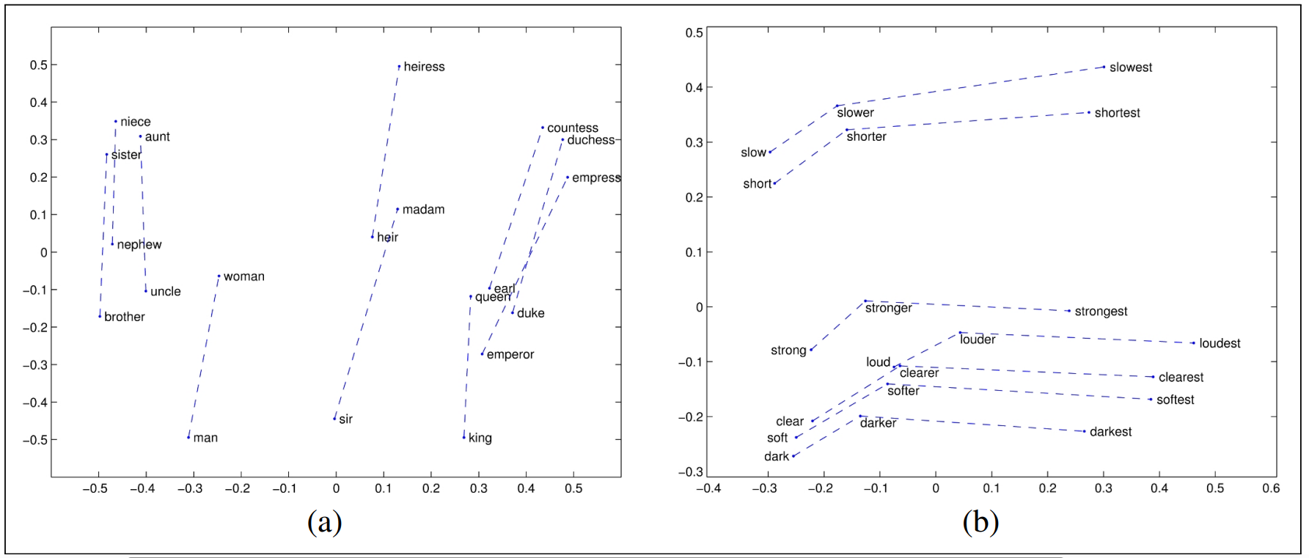
Text Embeddings in NLP
Daniel Jurafsky and James H. Martin, 2025. https://web.stanford.edu/~jurafsky/slp3.
(Figure 5.9, page 112)

Slide 6
Bayesian Latent-Space Modeling in Social Networks
Your goal for this project is to create and research such a latent space of representations for social networks using a probabilistic framework.
You will then be able to answer the questions for each exercise based on their inferred representation space. Use argumentation, in writing or code, to explain your approach not only for modeling but also for the answers.
The inference is based on the observations we provide you as interactions in the social network.
View this project from a research perspective, with each question allowing you to make sense and explain the latent space models you create. Use plots, figures, or tables that result from your modeling when solving the exercises.
! Don’t go overboard with the explanations, find the right balance!!!

Slide 7

Bayesian Latent-Space Modeling in Social Networks
For further reading, here are some research papers on modeling a latent space in social networks with an emphasis on Bayesian inference:
Latent Space Approaches to Social Network Analysis - Hoff et al., link
A Review of Latent Space Models for Social Networks - Sosa et al., link
Influence Networks: Bayesian Modeling and Diffusion - Sánchez-Gutiérrez et al., link
Spherical latent space models for social network analysis - Sosa et al., link
If you are interested in this topic don’t hesitate to ask more during the lecture or the lab, but remember that we will always stray the conversation away from the project as not to influence your solution.

Slide 8
Exercise 1 - 2-faction party
9
11
Each node represent a politician from a certain faction (A or B).
Each edge represents the number of private messages recorder in a month between two politicians
Q1: Who is the most influential politician from each faction?
Q2: Who are the two politicians that are best suited for inter-faction negotiations?
7
5
12
16
8
19
A
B

Slide 9
Exercise 2 - Split in the Roman Triumvirate
9
Caesar
Pompey
Crassus dies in 58 B.C. and the politicians following him now split between Pompey and Caesar. Each one has to choose a side.
Q1: Who gathered more politicians from Crassus’ faction?
Q2: Who are the most undecided politicians when it comes to choosing between Caesar and Pompey?
11
7
5
12
16
8
19
Crassus

Slide 10
Bayesian Latent-Space Modeling in Social Networks
You are required to create probabilistic programs that model what you see fit. We recommend PyMC for Bayesian inference, but if you want to use Stan or Pyro please notice us beforehand.
You are not required to answer the questions in a certain order, however it would be suspicious if you solve the second exercise but don’t know what to do in the first one.
We recommend you use only 2 dimensions for the latent representations so you wouldn’t have to drop other features or use PCA for 2-dimensional plots.
We recommend you solve the exercises in a notebook environment (Google Colab, Jupyter Notebook etc.) in order to better organize your code and visualizations.
We want you to put an emphasis on explanations and visualizations. Try to imagine your project notebook as a lab presentation for all computer scientists to understand.
Each question may contain nuances, try to address them based on your modeling results.

